Slide 1
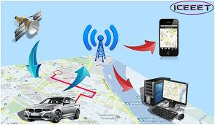
SPECIAL TOPIC PROJECT-EMBEDDED SYSTEMS DOMAIN
CAR ACCIDENT DETECTION SYSTEM
USING ARDUINO
By-
Astha Sinha
Shreya Srivastav
Suraj Krishna

Slide 2

Road accidents at a peak ?
Failure to locate the accident site.
Delay by the response team to reach the accident site is a major concern.
Source: https://www.thedailystar.net/frontpage/64-die-day-road-accidents-1361245

Slide 3
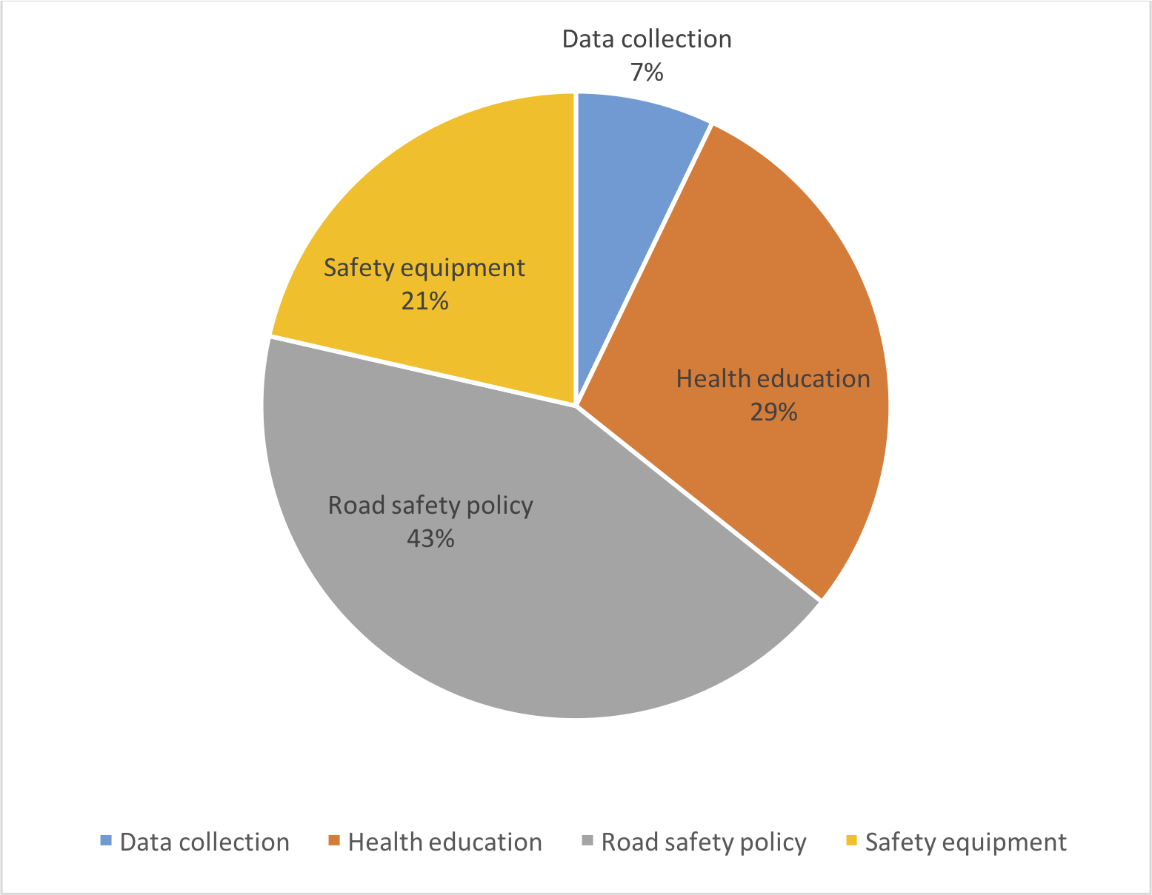
Road safety is of most importance
Figure - distribution of government expenditures

Slide 4
Objectives
To save human lives.
To alert authorities -police,ambulance
To develop quick sms mechanism that intimates about the occurrence of an accident.
Live location eccentric alert system.

Slide 5
So what do we propose?
This project presents an automotive localization system using GPS and GSM-SMS services to intimate the police station, nearby hospitals and family members that an accident has occurred.

Slide 6
Timeline of project
Phase 1
Literature Survey
Gather components
Design logic for accident detection using accelerometer
Phase 3
Read about AT commands for GSM
Individually test GSM module by sending messages.
Feb 2020
Apr 2020
Jan 2020
Mar 2020
Phase 2
Evaluate raw data from GPS module
Extract latitude & longitude values from raw data .
Integrate -accelerometer and gps modules to extract data from gps only when accident detected.
Phase 4
Integrate GSM with GPS and Accelerometer such that GPS sends the latitude and longitude values to GSM only when an accident is detected.

Slide 7
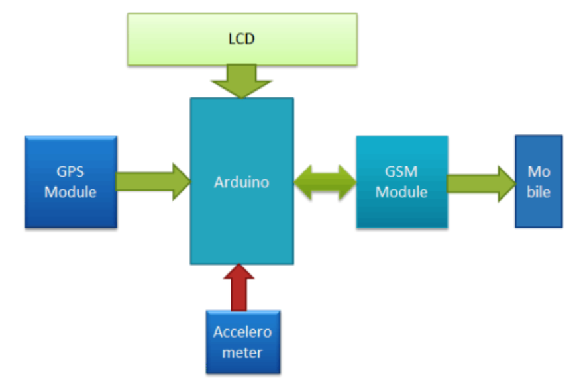
Block Diagram- main integration

Slide 8
Issues we might face..
GPS module fails to establish connection with satellite .
Lack of network for GSM operation.
Lack of complete raw data provided by GPS.
Getting ideal tuning parameters for accelerometer to detect if an accident has occurred.
Improper configurations of GSM AT commands.

Slide 9
Goals for next meeting
Design logic to estimate occurrence of an accident using accelerometer.
GPS module setup. Fetch latitude and longitude values from raw data.
Integrate both the modules.

